Slide 1
Deep Learning
Convoluted Neural Networks Part 2
Notes:
3/8/18
<number>

Slide 2
Suggested RoadMap
CNN
Image Classifications: Keras Basics
Transfer Learning Basics & FineTuning
Localization/Identification images.
Localization/ Identification in Videos
Face Identification in Video Feed
Andriod Mobile App for Identification.

Slide 3
Todays Agenda
Recap of Last Presentation.
Image & Image Loading.
Keras Basics for CNN using basic Dog vs Cat model.
MNIST model
Transfer Learning using Predict Function
Questions.

Slide 4
Images
Image Data Input Parameters:
number of images
image height
image width
number of channels
number of levels per pixel.
Image Preprocessing:
Aspect Ratio: Square. Cropping, giving importance to the middle of the image.
Image Scaling: We use 32x32 or 64x64, Good Practice to use an image size of Power of 2.
Mean, standard deviation of input data:
Normalizing image inputs: We divide our RGB images pixels by 255 to get them in [0,1] range. Helps against vanishing and exploding gradients, while probably also increasing convergence speed and accuracy.
Dimensionality reduction: Make a RGB into a Gray image( reduces 3 channels to 1)
Data Augmentation: Scaling, Rotating, Flipping, Adding Noise, Zoom , Shearing, Cropping

Slide 5
Image Directory Structure
DOGCAT_STUDY
KaggleCatDog
train
0_cats
1_dogs
validation
0_cats
1_dogs
UserData Inputs
UserData Outputs
Model
Weights

Slide 6
Loading Data
Use Keras ImageDataGenerator
Images are in a Tree like Directory structure, with LABEL subdirectories.
Train
cat
Image1.jpg
…
Image 200.jpg
dog
Image201.jpg
…
Image400.jpg

Slide 7
Loading Data (ImageDataGenerator cont’d)
Create the Generator for Training and Validation Images.
train_ImageDataGenerator = ImageDataGenerator (
rescale=1./255,
horizantal_flip=True,
zoom_range=0.3,
shear_range=0.3)
train_Generator = train_ImageDataGenerator.flow_from_directory(
train_data_directory,
target_size=(image_width, image_height),
batch_size=10,
class_mode=‘categorical’)
Nb: Class_Mode can be “categorical”, or “binary”.

Slide 8
Designing - CNN Models
There are lot of decisions to make when designing and configuring your deep learning models.
Many of these decisions, can be resolved by copying the structure of other Models.
Another approach is to design small experiments and evaluate options, using real data.
High Level Decisions: Number, Size and Types of layers in your Model.
Lower Level Decisions: Loss Functions, Activation Functions, Epoch, Batch size and Optimization Procedures.

Slide 9
Tuning a CNN -Hyper Parameters
Architecture
Number of Layers
Number of Neurons in each Layer
Regularization Parameters
Learning Rate
Dropout Rate
Weight Sharing
Activation Function (linear, sigmoid, tanh, relu)
Loss/Divergence Function (MSE, Cross Entropy, Binary Cross Entropy)
Algorithm for Weight updates (SGD, Adam, RMSProp…)

Slide 10
Keras Basics for CNN
Network Design
([CONV->ReLU->Pool->CONV->ReLU->Pool->FC->Softmax_loss(during train)])
Learning Parameters of a Model.
Hyper Parameters.
Model Checkpoints/Callbacks.
Model & Weights Save and Restore.
Optimizer, loss, Activation Functions

Slide 11
Sample Dogs vs Cats Code study.
Keras Model : Sequential Model
Functional Model.
Sequential Model API: Create a model Layer by Layer. It cannot create models that share layers or have multiple inputs or outputs.
Functional Model API: More Flexibility, can define models where layers connect to more that just the previous or next layers, allowing us to create more complex networks.

Slide 12
Sequential
model = Sequential()
model.add(Conv2D(32,(3,3), input_shape=(32,32,3)))
model.add(Flatten())
model.add(Dense(2))
Functional
visible = Input(shape=(2,))
hidden = Dense(2)(visible)
Model= Model(inputs=visible, outputs=hidden)

Slide 13
Flow
Define Model
Compile Model
Train Model
Save Model (optional)
Save Best Weights (optional)
Evaluate Model
Predict using saved Model

Slide 14
Model - Define
Conv2D(
filters,
kernel_size,
Strides=1,
Padding=“valid”,
input_shape)
Input_shape is only used in the first Input Layer.
All weights and biases are initialized by the API.
API works out all the Tensor shapes and sizes.
MaxPooling2D( pool_size,
strides,
padding
)

Slide 15
Flatten() : Flattens the input
Dense( units,
Activation
)
Dropout(rate)
Activation(activation)
“relu”,”sigmoid”,”softmax”,”tanh”
BatchNormalization()
Normalizes the activation of the previous layer, at each batch.

Slide 16
After defining the model, we have to compile it.
model.compile(
optimizer,
Loss,
metrics)
After Compilation we have to train it
history= model.fit(
Model,
Batch_size,
Epoch,
verbose,
Callbacks,
Validation_data,
Steps_per_epoch)

Slide 17
Compile-Metrics
Metric values are recorded at the end of each epoch on the training dataset.
If there is a validation dataset, then metrics are calculated for it as well.
Keras Regression Metrics
MSE ( Mean Squared Error)
MAE ( Mean Absolute Error)
MAPE( Mean Absolute Percentage Error)
cosine
Keras Classification Metrics
acc (Binary Accuracy/ Categorical Accuracy)
sparse_categorical_accuracy

Slide 18
Compile-Losses
Binary_crossentropy
used for 0/1 labels
Categorical_crossentropy
used for 1-N Labels

Slide 19
Compile-Optimizer
Optimizer algorithms help us to minimize the Error Function, which is dependent on the Models internal learnable parameters used in computing values from a set of predictors.
Weight and Bias are the internal Learnable parameters, which are updated by the Optimizer algorithm, and they influence the Models learning process and the output.
Optimizers we shall use are
Adam
RMSprop

Slide 20
MNIST- Tensorboard Demo
Refer to Code

Slide 21
Transfer Learning
Storing knowledge gained while solving one problem, and
applying it to a different but related problem.
Why use Transfer Learning.
Training a Model, from scratch, requires lot of input data.
Very deep networks are very resource and cash expensive.
Determining the topology, and hyperparameters is black magic.

Slide 22
Transfer Learning for Images
ImageNet :
14 Million Pictures
20,000 Categories
Ready Made Models
Xception
VGG16
VGG19
ResNet50
InceptionV3
InceptionResNetV2
MobileNet
DenseNet
NASNet

Slide 23
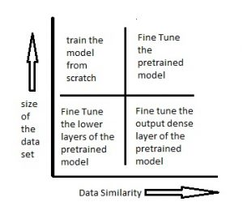
Transfer Learning Fine Tuning

Slide 24
When to FineTune a PreTrained Model
New dataset is small and similar to original dataset.
Since the data is small, it is not a good idea to fine-tune the ConvNet due to overfitting concerns.
Since the data is similar to the original data, we expect higher-level features in the ConvNet to be relevant to this dataset as well.
Hence, the best idea might be to train a linear classifier on the CNN codes.
New dataset is large and similar to the original dataset.
Since we have more data, we can have more confidence that we won’t overfit if we were to try to fine-tune through the full network.
New dataset is small but very different from the original dataset.
Since the data is small, it is likely best to only train a linear classifier.
Since the dataset is very different, it might not be best to train the classifier form the top of the network, which contains more dataset-specific features.
Instead, it might work better to train the SVM classifier from activations somewhere earlier in the network.
New dataset is large and very different from the original dataset.
Since the dataset is very large, we can afford to train a ConvNet from scratch.
However, in practice it is very often still beneficial to initialize with weights from a pretrained model.
In this case, we would have enough data and confidence to fine-tune through the entire network.

Slide 25
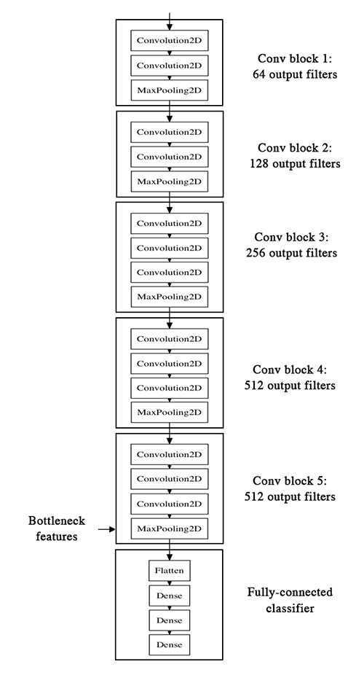
VGG16 Architecture

Slide 26
Transfer Learning – Dogs vs Cats
See code

Slide 27
Questions

Slide 28
Contact Details
Email: aliasgertalib@gmail.com
Linkedin: https://www.linkedin.com/in/aliasgertalib

